Slide 1
SAP HANA Installation

Slide 2
Installing HANA 2.0 on SUSE 12 Linux

Slide 3
Prerequisites
Required Notes to be referred before Installing SAP HANA 2.0
2205917 -SAP HANA DB: Recommended OS settings for SLES12 /SLES
2404375 – SAP HANA Platform 2.0 SPS 01 Release Note
2399995 – Hardware requirement for SAP HANA 2.0
2235581 – SAP HANA: Supported Operating Systems
1943937 – Hardware Configuration Check Tool – Central Note

Slide 4
SAP HANA Installation planning
The best place to start the planning for any SAP system is with SAP product master guide and HANA is not an exception. We will recommend you to read following document to introduce yourself to SAP HANA and various installation options.
HANA Master guide.
HANA Installation and update guide.
HANA release specific SAP note.
HANA Master, Installation and Update guides. The central place to find these documents is help.sap.com(http://help.sap.com/hana_platform/#section2) . PFB the direct link for these documents.
Master Guide direct link : http://help.sap.com/hana/SAP_HANA_Master_Guide_en.pdf
SAP HANA Installation Guide : http://help.sap.com/hana/SAP_HANA_Server_Installation_Guide_en.pdf
HANA release specific notes:
1514967 - SAP HANA: Central Note : Refer this SAP HANA central note, this will provide you link to key SAP HANA revision notes. For every HANA revision , SAP releases a note for that particular revision number . Please read these notes once you have decide the HANA revision/version that you are planning to install.

Slide 5
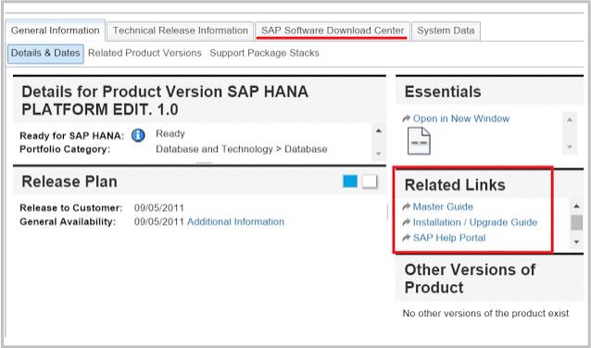
Product Availability Matrix (PAM)
PAM : PAM is the key tool for SAP product installation planning. Go to following URL and search for
SAP HANA https://service.sap.com/sap/support/pam .
You can also find these docs links in SAP PAM(Product Availability Matrix) for HANA(shown below).

Slide 6
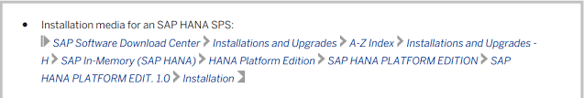
Download HANA installation media
Downloading the required media and preparing the system.
We have to make sure all the prerequisites are met before we start the HANA installation.
Download SAP HANA Media:
Go to SAP Software component download site : http://support.sap.com/swdc
Select 'Installation and Upgrades' from left menu.
Now follow the path highlighted in below screenshot and download the latest client media file(highlighted).
Extract the media and copy it on the server.

Slide 7
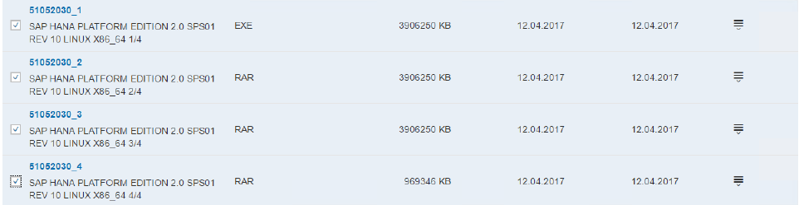
Software download
Download the SAP HANA 2.0 software media from service market place.
SAP IN-MEMORY (SAP HANA ) / HANA PLATFORM EDITION / SAP HANA PLATFORM EDITION / SAP
HANA PLATFORM EDITION 2.0 / INSTALLATION
Download below CD’s for HANA 2.0 sps01
HANA 2.0 (51052030_1 to 4) — SAP HANA PLATFORM EDITION 2.0 SPS01 REV 10 LINUX X86_64 1/4 ,
2/4, 3/4 and 4/4

Slide 8
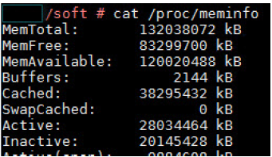
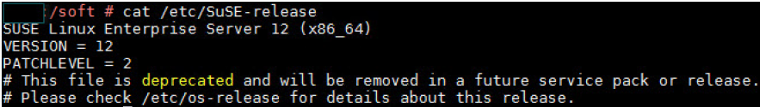
Checking Memory allocation
cat /proc/meminfo
Check the installed OS version
Cat /etc/SuSE-release

Slide 9
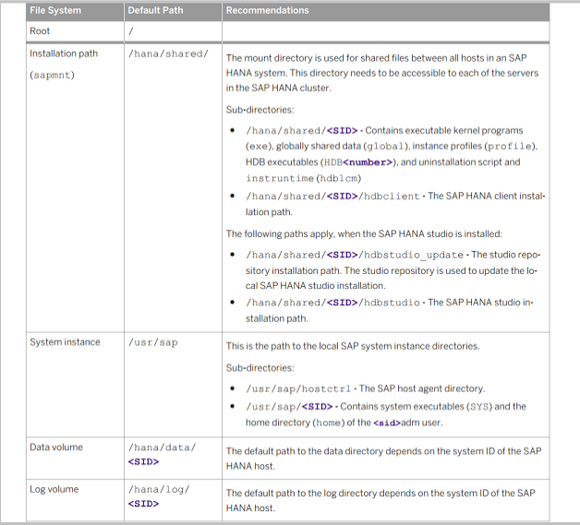
Prepare the required file system
We need following mandatory file system to install SAP HANA.
Before you go ahead and create the mandatory file system, make sure you have enough space/storage allocated. Since we are making a sandbox system for educational purpose , I have chosen following low configuration .
RAM : 30 GB (Minimum is 24 GB , otherwise the installer will throw error)
Persistence storage(SSD) : 65 GB total.
20 GB for root
15 GB for the installation media(DVD).
20 GB for Data
10 GB for Log.

Slide 10
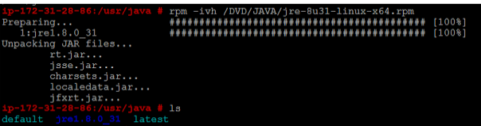
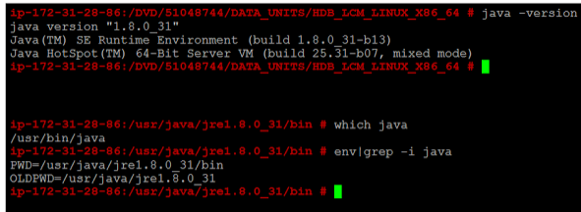
Install JAVA :
To install SAP HANA we need JAVA 64 bit, one can install Java 1.6/1.7 or 1.8.
We are installing JAVA as recommended in following URL and make sure JAVA added to environment variables.
Installing JAVA :https://www.java.com/en/download/help/linux_x64rpm_install.xml

Slide 11
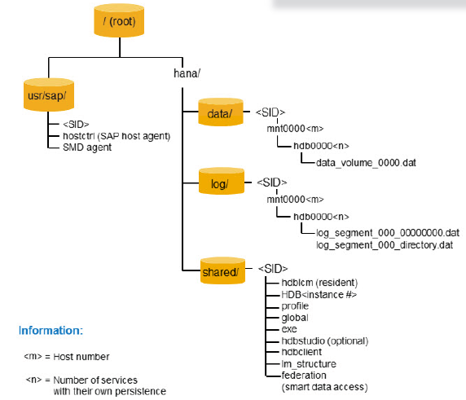
Recommended File System Layout
Root /
Installation path(sapmnt) /hana/shared/
System instance /usr/sap
Data volume /hana/data/<SID>
Log volume /hana/log/<SID>

Slide 12
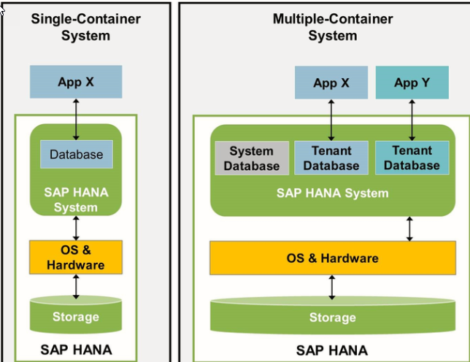
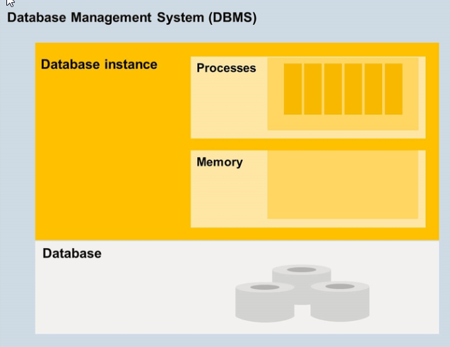
Multi-tenant System

Slide 13
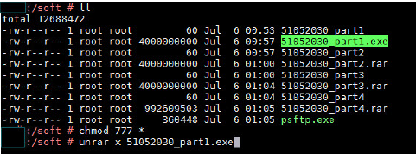
HANA Database Installation
Starting from HANA 2.0 SPS 01, multitenant database containers (MDC) will be the only operational mode for SAP HANA database, this means Single container database no longer exist in HANA 2.0 SPS01.
Extracting Software dump
Running the setup file
HANA database lifecycle manager (HDBLCM) is used to install SAP HANA database, including server, client, studio, and additional components, in a graphical user interface, command-line interface and new web user interface.
Login as root, switch to the software dump location
/soft/51052030/DATA_UNITS/HDB_LCM_LINUX_X86_64 / and run below setup file
./hdblcmgui

Slide 14
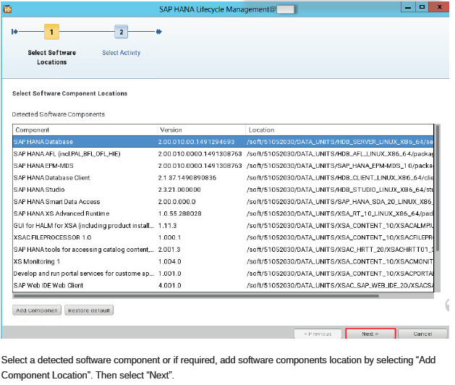
The SAP HANA database lifecycle
manager (hdblcm) graphical user
interface appears.

Slide 15
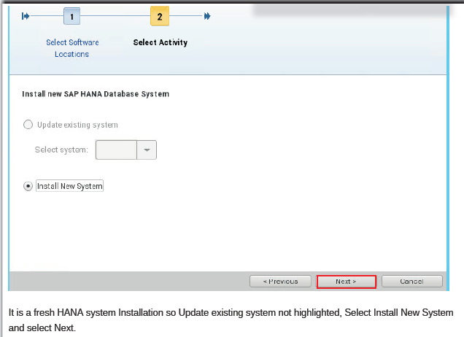

Slide 16
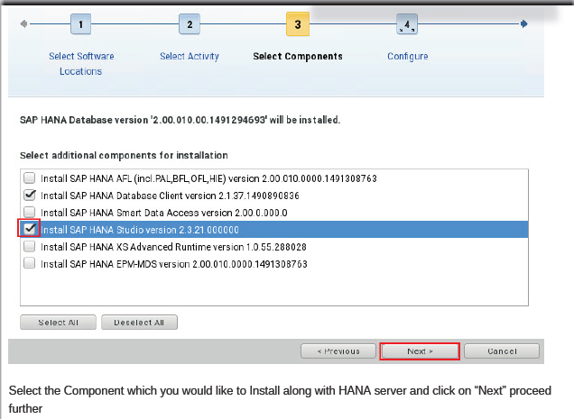

Slide 17
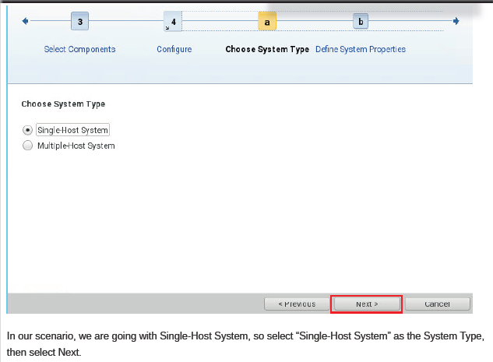

Slide 18
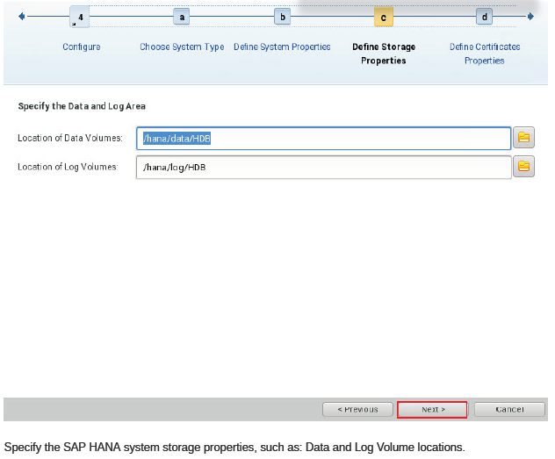

Slide 19
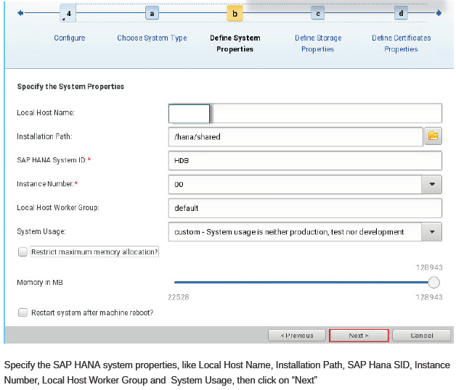

Slide 20
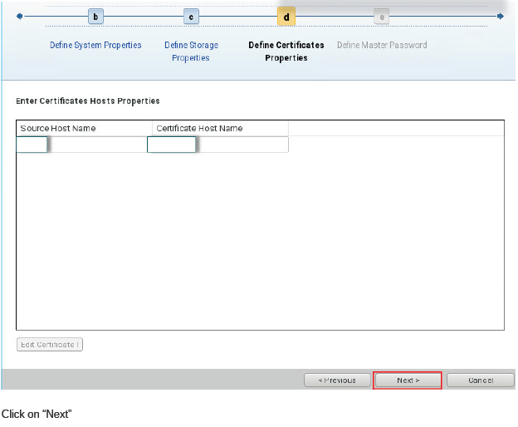

Slide 21
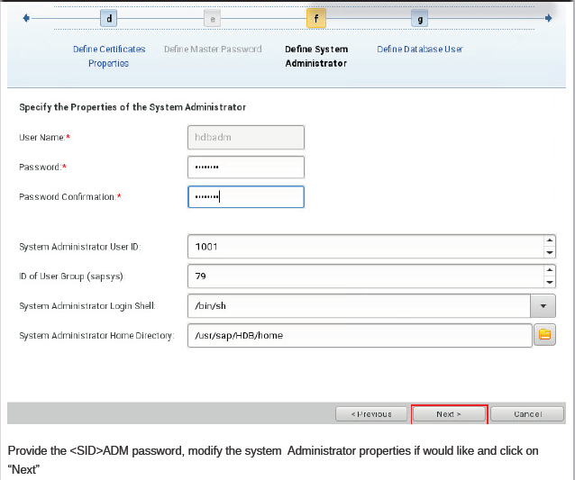

Slide 22
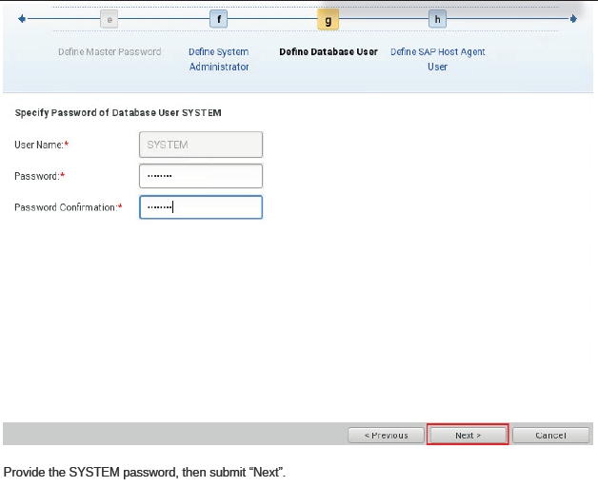
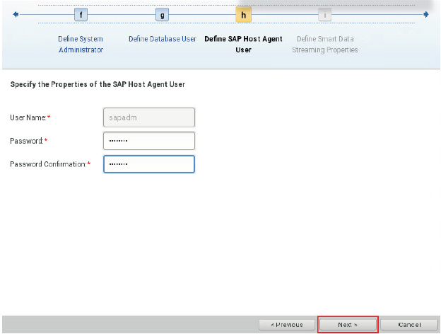

Slide 23
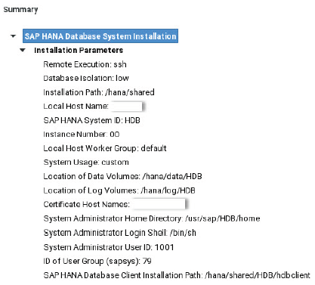
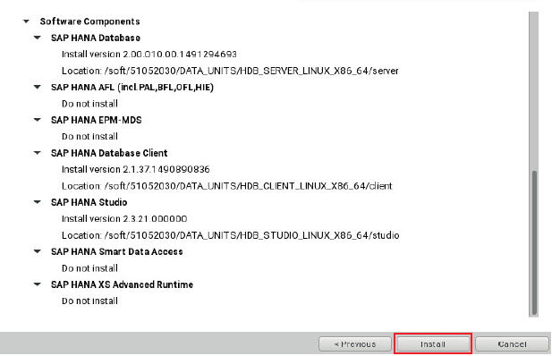
Review the Installation parameters and click “Install” to trigger the SAP HANA 2.0 SP01 Installation.

Slide 24
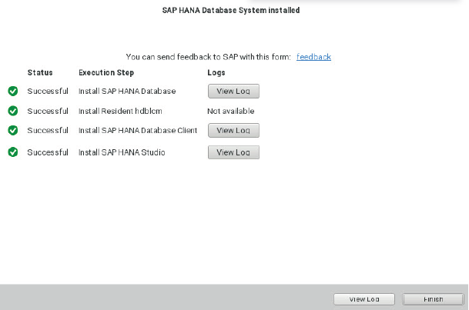
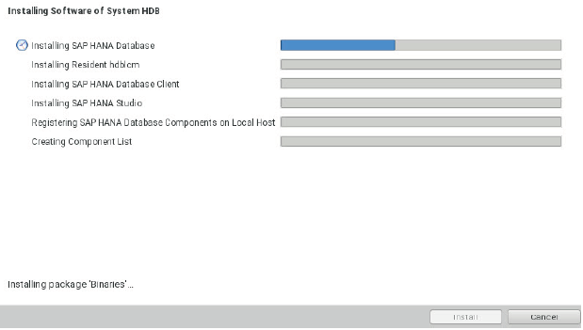
HANA2.0 Installation completed successfully. Installation logs can be viewed in below locations.
/var/tmp and /var/tmp/hdb_HDB_hdblcm_install_*Date*_*Time* directory

Slide 25
SAP HANA Studio Installation
Supported Platform
SAP HANA Studio runs on below platform –
Microsoft Windows x32 and x64 versions-
Window XP
Window Vista
Window 7
Window 8
SUSE Linux Enterprises Server: x86 64 Bit version, Red Hat Enterprises Linux (6.5).
Mac OS 10.9 or Higher.
System Requirement
JAVA JVM – During Installation and updating of SAP HANA Studio, a JVM is installed or updated.
SAP HANA Client – It is software, by which you will be able to connect any other database, application.
SAP HANA Client can be installed on Unix / Linux and Microsoft Windows and also on SAP HANA Server host during server installation. SAP HANA Client installed separately from SAP HANA studio.

Slide 26
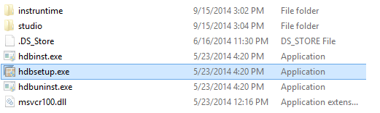
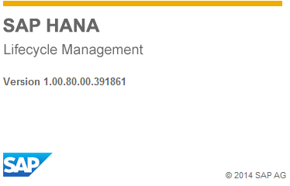
Download & Install SAP HANA Studio
Installation Path
The default installation on system path according to OS and their
version is as below
Microsoft Window (32 & 64 bit)- C:\Program files \sap\hdbstudio.
Linux x86, 64 bit - /user / sap / hdbstudio.
Mac OS , 64 bit - /Applications / sap / hdbstudio.app
Installation on Microsoft Window
Install SAP HANA Studio in the default directory with administration
privileges or in user home folder without administration privileges.
Click on hdbsetup.exe for installing SAP HANA studio
A SAP HANA Lifecycle Management Screen appears.

Slide 27
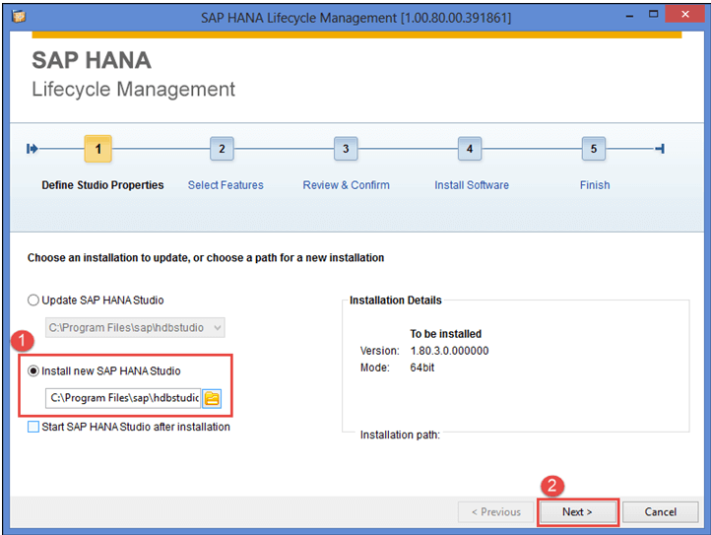
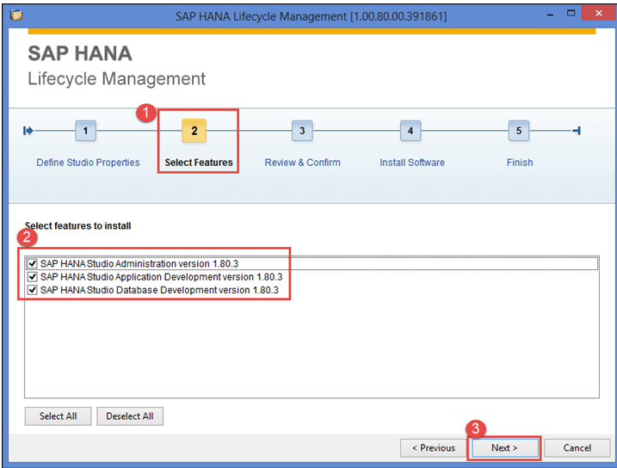
Default installation folder is C:/Program Files / SAP / hdbstudio.
Step 1) Define Studio Properties
Select install new SAP HANA Studio.

Slide 28
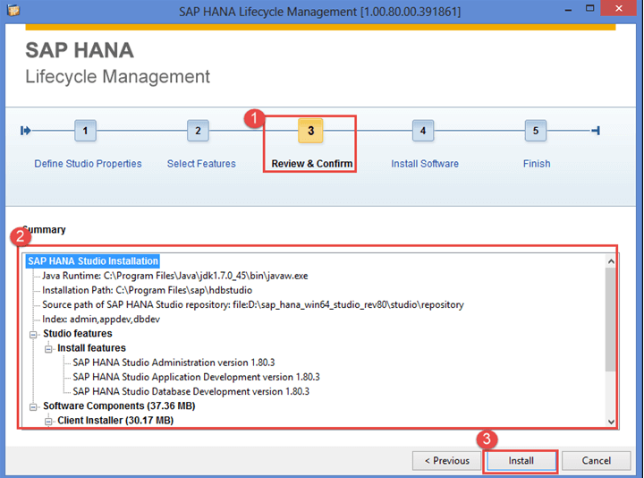
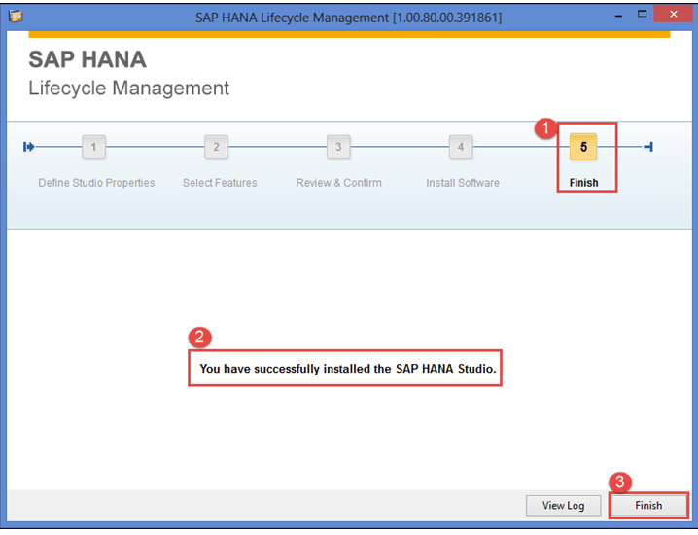

Slide 29
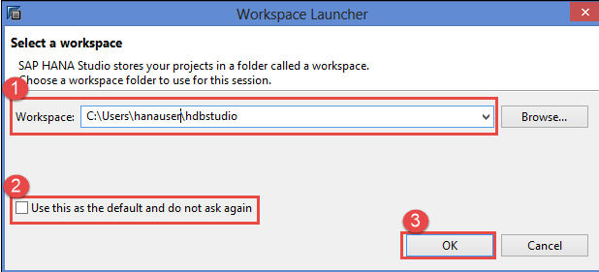
Run SAP HANA Studio
Now, go to Default installation folder is "C:/Program Files / SAP / hdbstudio".
There is hdbstudio.exe file, by right clicking on it, you can create a shortcut on the desktop
Workspace is selected by default. We can change Workspace location by Browse option. Workspace is used to store studio configuration settings and development artifacts.
Select "Use this as the default and do not ask again" option to prevent popup this screen every time for workspace selection when we open SAP HANA Studio.

